Slide 1
Introduction to R
Association for Pathology Informatics Summit 2019

Slide 2
Course Introduction

Slide 3
7:00 am - 8:00 am | BREAKFAST - BALLROOM LOBBY - 2ND FLOOR
8:00 am - 8:10 am | Instructor Instructions
8:10 am - 9:50 am | Introduction to R and RStudio for Reproducible Reporting
9:50 am - 10:10 am | REFRESHMENT BREAK - BALLROOM LOBBY - 2ND FLOOR
10:10 am - 11:50 am | Data Wrangling
12:00 pm - 1:00 pm | LUNCH - BALLROOM LOBBY - 2ND FLOOR
1:00 pm - 2:50 pm | Data Understanding
2:50 pm - 3:10 pm | REFRESHMENT BREAK - BALLROOM LOBBY - 2ND FLOOR
3:10 pm - 5:00 pm | Exploratory Data Analysis
Notes:
In the first block we will introduce ourselves to R and the concepts of reproducible reporting.
First Hour: Getting oriented to the R programming language and basic coding concepts
Second Hour: Learning reproducible reporting practices and tools in R

Slide 4
Who are we?

Slide 5
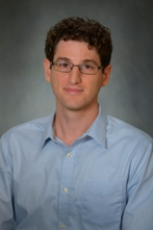
Daniel Herman
Assistant Professor of Pathology and Laboratory Medicine
University of Pennsylvania Perelman School of Medicine
Director, Endocrinology Laboratory
Hospital of the University of Pennsylvania
Notes:
Daniel S. Herman
Assistant Professor of Pathology and Laboratory Medicine, University of Pennsylvania; Director of Endocrinology, Hospital of the University of Pennsylvania
PHILADELPHIA, PA | daniel.herman2@pennmedicine.upenn.edu
Daniel Herman practices clinical pathology at the University of Pennsylvania, where he directs the Endocrinology laboratory at the Hospital of the University of Pennsylvania. He completed his MD and PhD degrees at Harvard Medical School and trained in Clinical Pathology at the University of Washington. His current clinical practice, in addition to clinical chemistry, includes leading informatics projects to make better use of existing laboratory data in the form of live operational dashboards, test utilization reports, and identification of missing patient diagnoses. His research group has been developing EHR-based methods to improve population health screening, focused recently on improving population hypertension management by identifying patients with undiagnosed primary aldosteronism. He is also interested in the intersection of pathology and policy and currently serves as College of American Pathology State Issue Advisor for Pennsylvania.

Slide 6
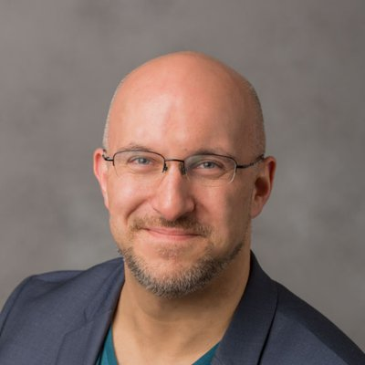
Stephan Kadauke
Assistant Professor of Clinical Pathology and Laboratory Medicine
University of Pennsylvania Perelman School of Medicine
Assistant Director of the Cell and Gene Therapy Laboratory
Children's Hospital of Philadelphia
Notes:
Bio:
After completing high school in Germany, Stephan crossed the Atlantic to study in New York City. From there, he went on to complete Penn's Medical Scientist Training Program (MSTP). In his Pathology residency, Stephan was shocked by the lack of informatics education. So he developed a course in data science specifically tailored for physicians and other health care professionals who deal with clinical data, and he's teaching this course at the Perelman School of Medicine at the University of Pennsylvania.
Stephan works at CHOP where he serves as the Assistant Director of the Cell and Gene Therapy Lab. He is also a part of the new Division of Pathology Informatics where he is promoting physician informatics education.

Slide 7
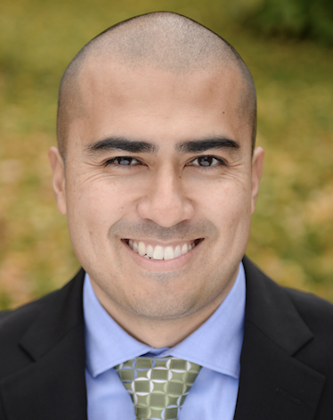
Patrick Mathias
Assistant Professor, Department of Laboratory Medicine
University of Washington School of Medicine
Associate Medical Director, Laboratory Medicine Informatics
Notes:
Patrick Mathias, MD, PhD, is the Associate Medical Director of the Informatics Division in the Department of Laboratory Medicine at the University of Washington School of Medicine. He completed his MD and PhD in Bioengineering at the University of Illinois in Urbana-Champaign, followed by a clinical pathology residency and a clinical informatics fellowship at the University of Washington School of Medicine. His interests include developing data science and analytics as a core competency to improve clinical lab operations and laboratory stewardship, and applying clinical informatics approaches to mitigate laboratory-associated diagnostic errors. He is interested in developing and improving programming and data science education across all levels of pathology practice.

Slide 8
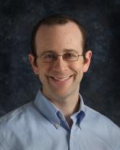
Amrom Obstfeld
Assistant Professor of Clinical Pathology and Laboratory Medicine
University of Pennsylvania Perelman School of Medicine
Assistant Director of Hematology and Coagulation Laboratories
Children's Hospital of Philadelphia
Notes:
Amrom Obstfeld MD, PhD, is the Medical Director of the Division of Pathology Informatics as well as the Hematology Laboratory at Children’s Hospital of Philadelphia. After receiving his MD and PhD degrees from the College of Physicians and Surgeons at Columbia University, he went on to train in Clinical Pathology at the Hospital of the University of Pennsylvania. In addition to his duties within the Hematology Laboratory, Dr. Obstfeld’s clinical responsibilities include leading the development of analytic tools to aid in laboratory quality management, administration, and operation, and interfacing with other groups throughout the hospital on informatics initiatives.. His research focuses on utilizing clinical and pre-clinical laboratory data sets for predicting diagnosis and prognosis using statistical and machine learning techniques. Dr. Obstfeld plays a major role in designing and implementing educational experiences for pathology trainees and faculty at the University of Pennsylvania within the areas of clinical and pathology informatics.

Slide 9
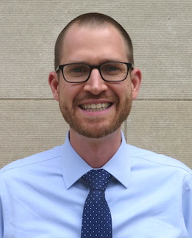
Joseph Rudolf
Assistant Professor, Department of Laboratory Medicine and Pathology, University of Minnesota
Director of Laboratory Medicine and Pathology Informatics, Department of Laboratory Medicine and Pathology, University of Minnesota
Laboratory Medicine and Pathology Chief Medical Informatics Officer, Fairview Health Services
Notes:
Joseph Rudolf, MD is the Director of Laboratory Medicine and Pathology Informatics in the Department of Laboratory Medicine and Pathology at the University of Minnesota in Minneapolis, Minnesota. He earned his medical degree (2012) from the University of Washington School of Medicine in Seattle, Washington. He completed his residency training in Clinical Pathology (2015) and fellowship in Clinical Informatics (2017) at the Massachusetts General Hospital in Boston, Massachusetts. His clinical and research interests focus on the intersection of informatics and clinical operations including clinical decision support, utilization management, and reporting and analytics. He is also passionate about clinical process improvement and initiatives to support quality and safety.

Slide 10
Who are you?

Slide 12
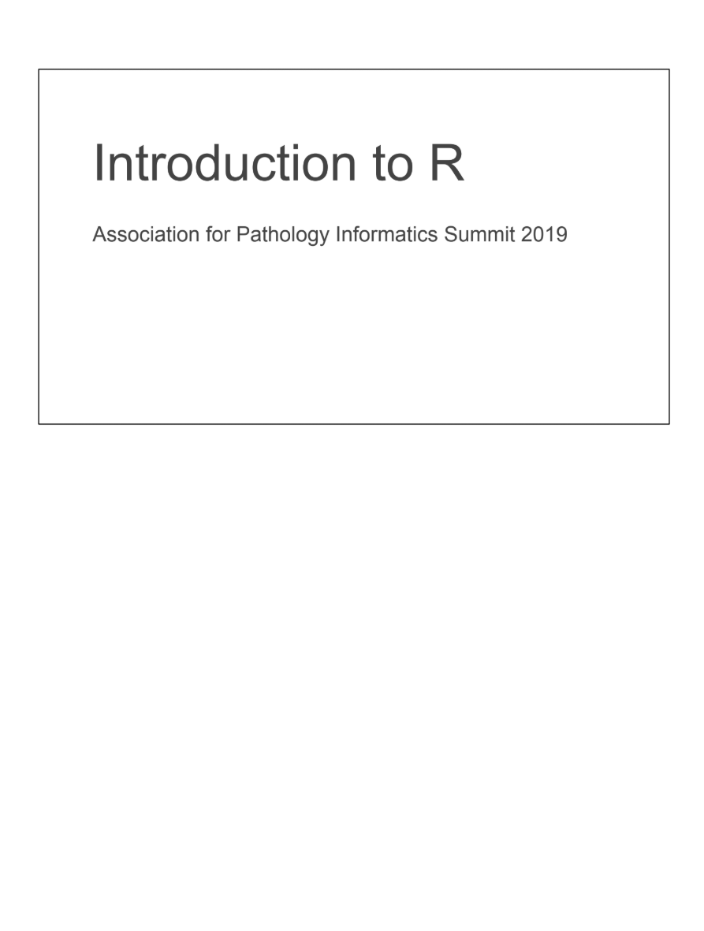
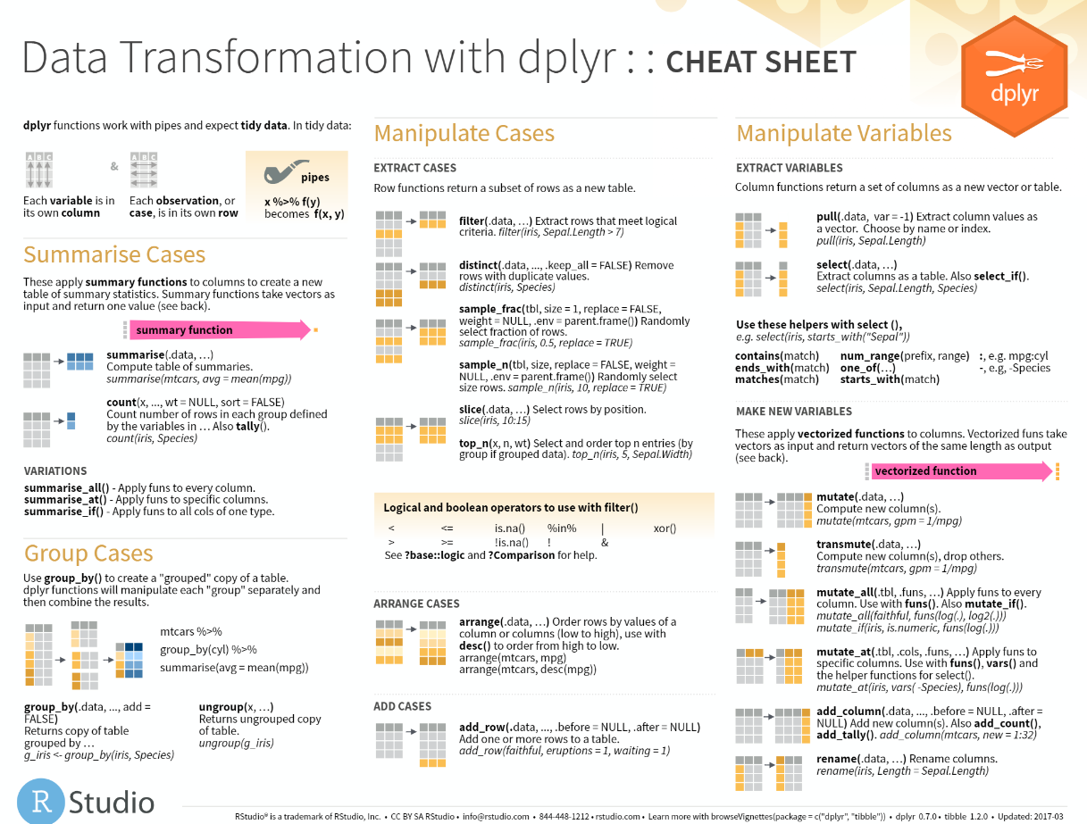
Course Materials
Course Textbook
Slides with course notes
Cheatsheets
Resources

Slide 13
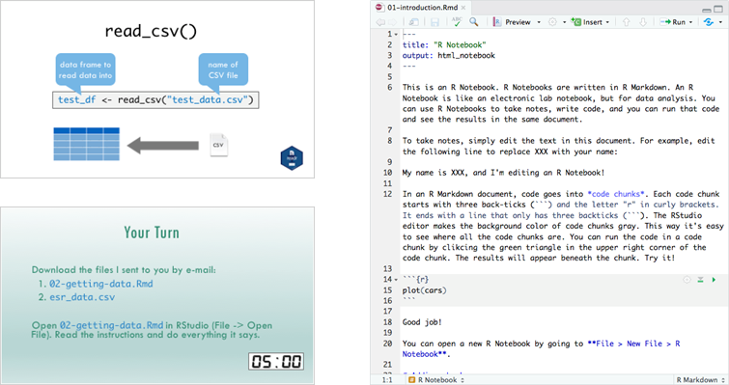
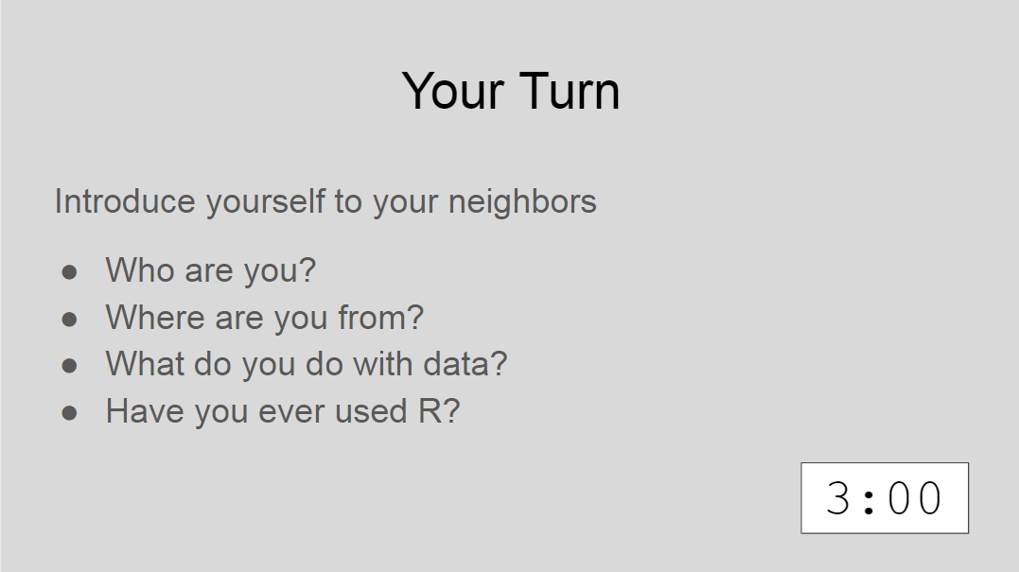
Lectures

Slide 14
Your Turn
Introduce yourself to your neighbors
Who are you?
Where are you from?
What do you do with data?
Have you ever used R?
3:00

Slide 15
Final Tips
Remember that computers are not actually that smart: R will do exactly what you tell it to do, even if that’s not what you want! Your code can’t have errors because R can’t figure out what you mean.
Take the “copy, paste, and tweak” approach: It is often much easier to taking existing code that you know works and modify it to suit your ends, rather than trying to write new code from scratch. Exercise ctrl-C/ctrl-V!
Moderndive.com

Slide 16
Final Tips
The best way to learn to code is by doing: Find a project, make a goal, and push yourself to use R!
Practice is key!
Moderndive.com

